Slide 1


Department of BES-1
DATA STRUTURES
24SC1204
Topic:
BINARY HEAP, HEAP SORT ANAYSIS & IMPLEMENTATION
Session - 31

Slide 2



AIM OF THE SESSION
To familiarize students with the basic concept of Binary ,Heap heap sort and its implementation
INSTRUCTIONAL OBJECTIVES
This Session is designed to:
DEMONSTRATE THE BINARY HEAP, HEAP SORT
DESCRIBE THE HEAPIFYING
LIST OUT THE TYPES OF HEAPIFYING
LEARNING OUTCOMES
At the end of this session, you should be able to:
DEFINE MAX HEAP AND MIN HEAP
DESCRIBE HEAPIFYING
SUMMARIZE

Slide 3
INTRODUCTION TO HEAP SORT
Definition: A binary heap is a Complete Binary Tree where items are stored in a special order such that value in a parent node is greater (Max Heap or smaller Min Heap) than the values in its two child nodes.​
A complete binary tree is a binary tree in which all the levels are completely filled except possibly the lowest one, which is filled from the left.​
Heap divided into two types
Max heap and min heap
Max heap is root is large when compared to children.
Min heap is root is smaller when compared to children.
Applications:
• Heaps have an average time complexity of O(log n) for inserting and deleting elements, making them efficient for large datasets.
• Heaps can be implemented as either a max-heap or a min-heap, making them flexible to use for different types of applications, such as priority queues or sorting algorithms.

Slide 4
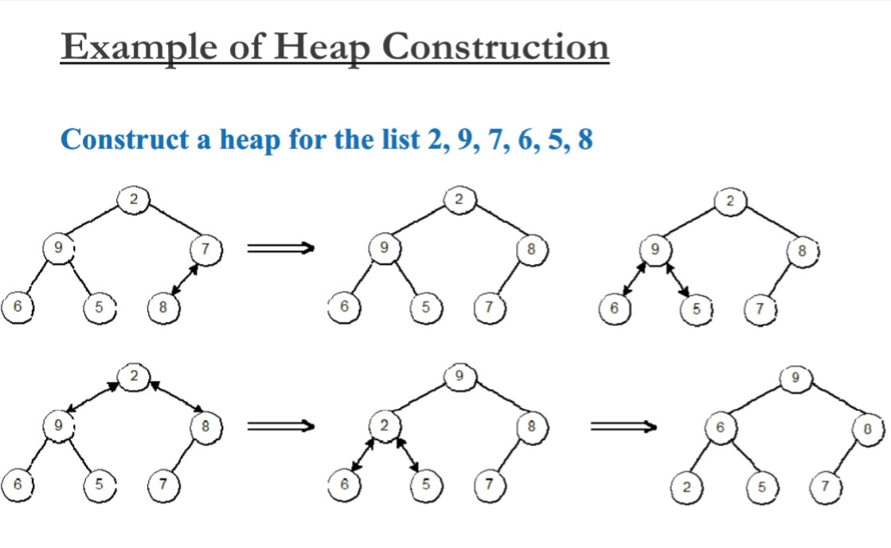
Heap Construction Algorithm
Step 1: Create a new node at the end of heap.
Step 2: Assign new value to the node.
Step 3: Compare the value of this child node with its parent
Step 4: If value of parent is less than child, then swap them
Step 5: Repeat step 3 & 4 until Heap property holds.

Slide 5
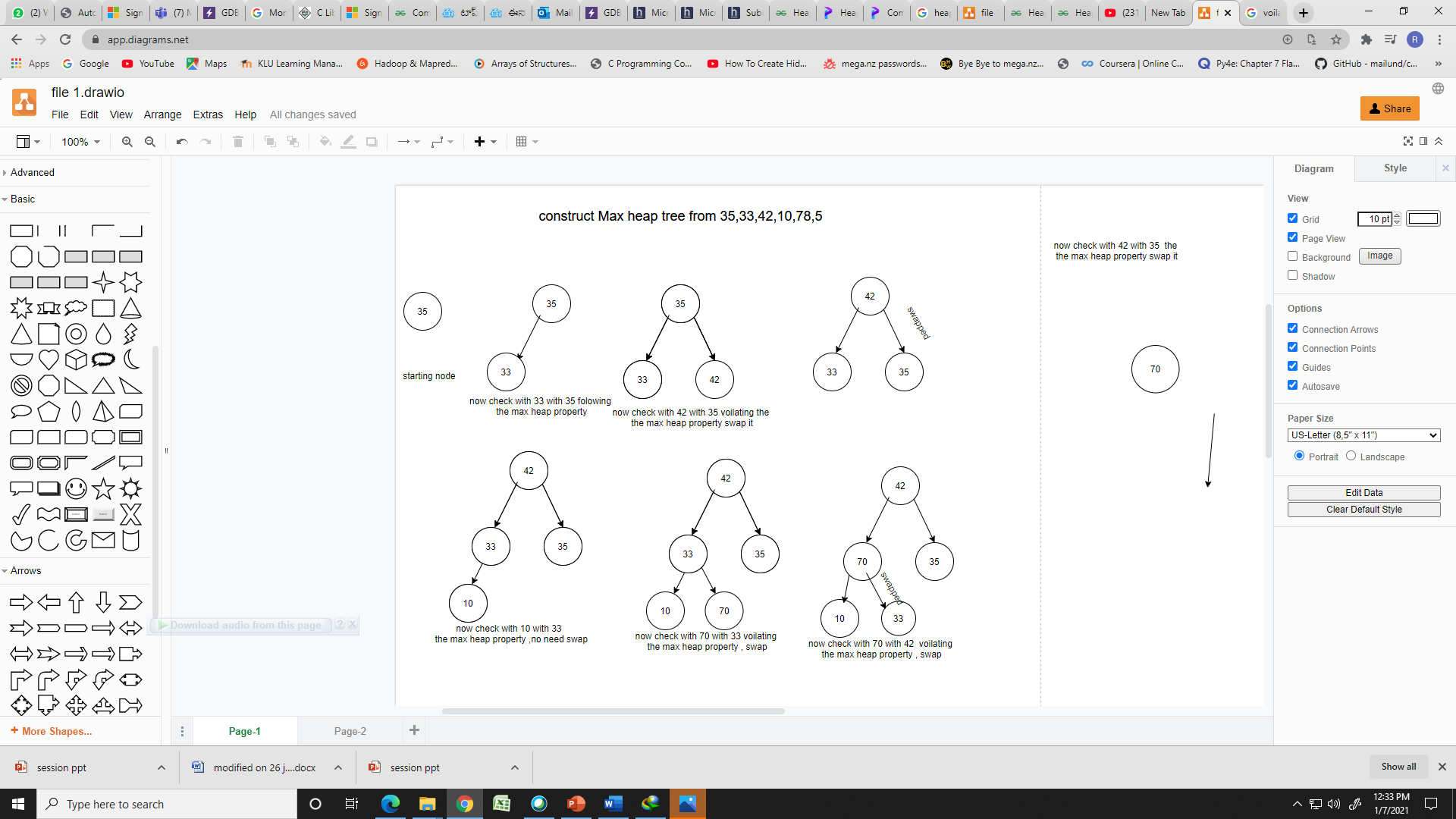
Construction of max heap tree

Slide 6
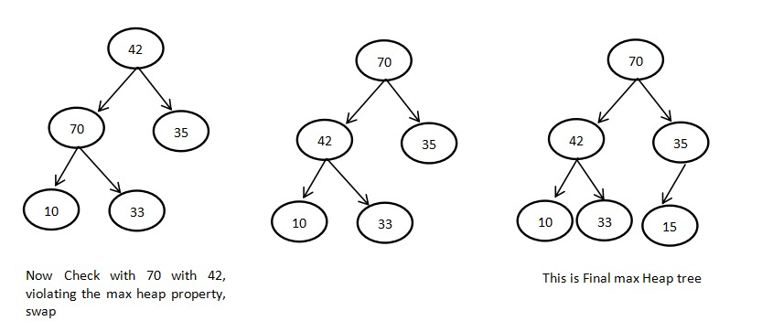
Construction of max heap tree(Cont..)

Slide 7
Heap Sort Algorithm for sorting in decreasing order
1. Build a Max Heap:
  Convert the given array into a max heap, which is a binary tree where each parent node is greater than or equal to its child nodes. This ensures that the largest element is at the root of the heap.
2. Extract Elements from the Heap:
  Once the max heap is built, the root element will always be the maximum. We repeatedly swap the root (the maximum element) with the last element of the heap. This will move the maximum element to its correct position in the sorted array.
  After swapping, reduce the size of the heap by one and heapify the root to maintain the heap property.
3. Repeat:
  Continue the process of swapping the root and the last element, followed by heapifying the root, until the heap is empty. This will produce the sorted array in decreasing order.

Slide 8
Heap Sort coding for sorting in decreasing order
# Function to heapify a subtree rooted at index i
def heapify(arr, n, i):
largest = i # Initialize largest as root
left = 2 * i + 1 # Left child
right = 2 * i + 2 # Right child
if left < n and arr[left] > arr[largest]: # If left child is larger than root
largest = left
if right < n and arr[right] > arr[largest]: # If right child is larger than largest so far
largest = right
if largest != i: # If largest is not root
arr[i], arr[largest] = arr[largest], arr[i] # Swap
heapify(arr, n, largest) # Recursively heapify the affected subtree

Slide 9
Heap Sort Algorithm for sorting in decreasing order
# Function to implement Heap Sort
def heap_sort(arr):
n = len(arr)
for i in range(n // 2 - 1, -1, -1): # Build a max heap (rearrange the array)
heapify(arr, n, i)
for i in range(n - 1, 0, -1): # One by one extract elements from the heap
arr[i], arr[0] = arr[0], arr[i] # Swap the root (max element) with the last element
heapify(arr, i, 0) # Heapify the root element
arr = [12, 11, 13, 5, 6, 7]
heap_sort(arr)
print("Sorted array in decreasing order is:", arr)
OUTPUT :
Sorted array in decreasing order is: [5, 6, 7, 11, 12, 13]

Slide 10
Heap Sort Algorithm for sorting in increasing order
Heap Sort Algorithm Steps (for Increasing Order)
1. Build a Max Heap:
  Convert the given array into a max-heap (binary tree where each parent node is greater than or equal to its child nodes). The largest element will be at the root of the heap.
2. Extract Elements from the Heap:
  The root of the heap contains the maximum element. Swap the root (maximum element) with the last element of the heap. This places the maximum element in its correct position.
  After the swap, reduce the heap size by 1 (exclude the last element, as it’s now in the correct position) and heapify the root to restore the max-heap property.
3. Repeat:
  Continue the process of swapping the root and the last element, followed by heapifying the root, until the heap is reduced to a size of 1. This process will produce a sorted array in increasing order.

Slide 11
Heap Sort Algorithm for sorting in increasing order
def heapify(arr, n, i):
largest = i
left = 2 * i + 1
right = 2 * i + 2
# Check if left child is larger than root
if left < n and arr[left] > arr[largest]:
largest = left
# Check if right child is larger than largest
if right < n and arr[right] > arr[largest]:
largest = right
# If largest is not root, swap and continue heapifying
if largest != i:
arr[i], arr[largest] = arr[largest], arr[i]
heapify(arr, n, largest)

Slide 12
Heap Sort Algorithm for sorting in increasing order
def heapSort(arr):
n = len(arr)
for i in range(n // 2 - 1, -1, -1): # Build a max heap
heapify(arr, n, i)
for i in range(n-1, 0, -1): # Extract elements from heap one by one
arr[i], arr[0] = arr[0], arr[i] # Swap the root (largest) element with the last element
heapify(arr, i, 0) # Call heapify on the reduced heap
arr = [4, 10, 3, 5, 1]
print("Original Array:", arr)
heapSort(arr)
print("Sorted Array in Increasing Order:", arr)
OUTPUT :
Original Array: [4, 10, 3, 5, 1]
Sorted Array in Increasing Order: [1, 3, 4, 5, 10]

Slide 13
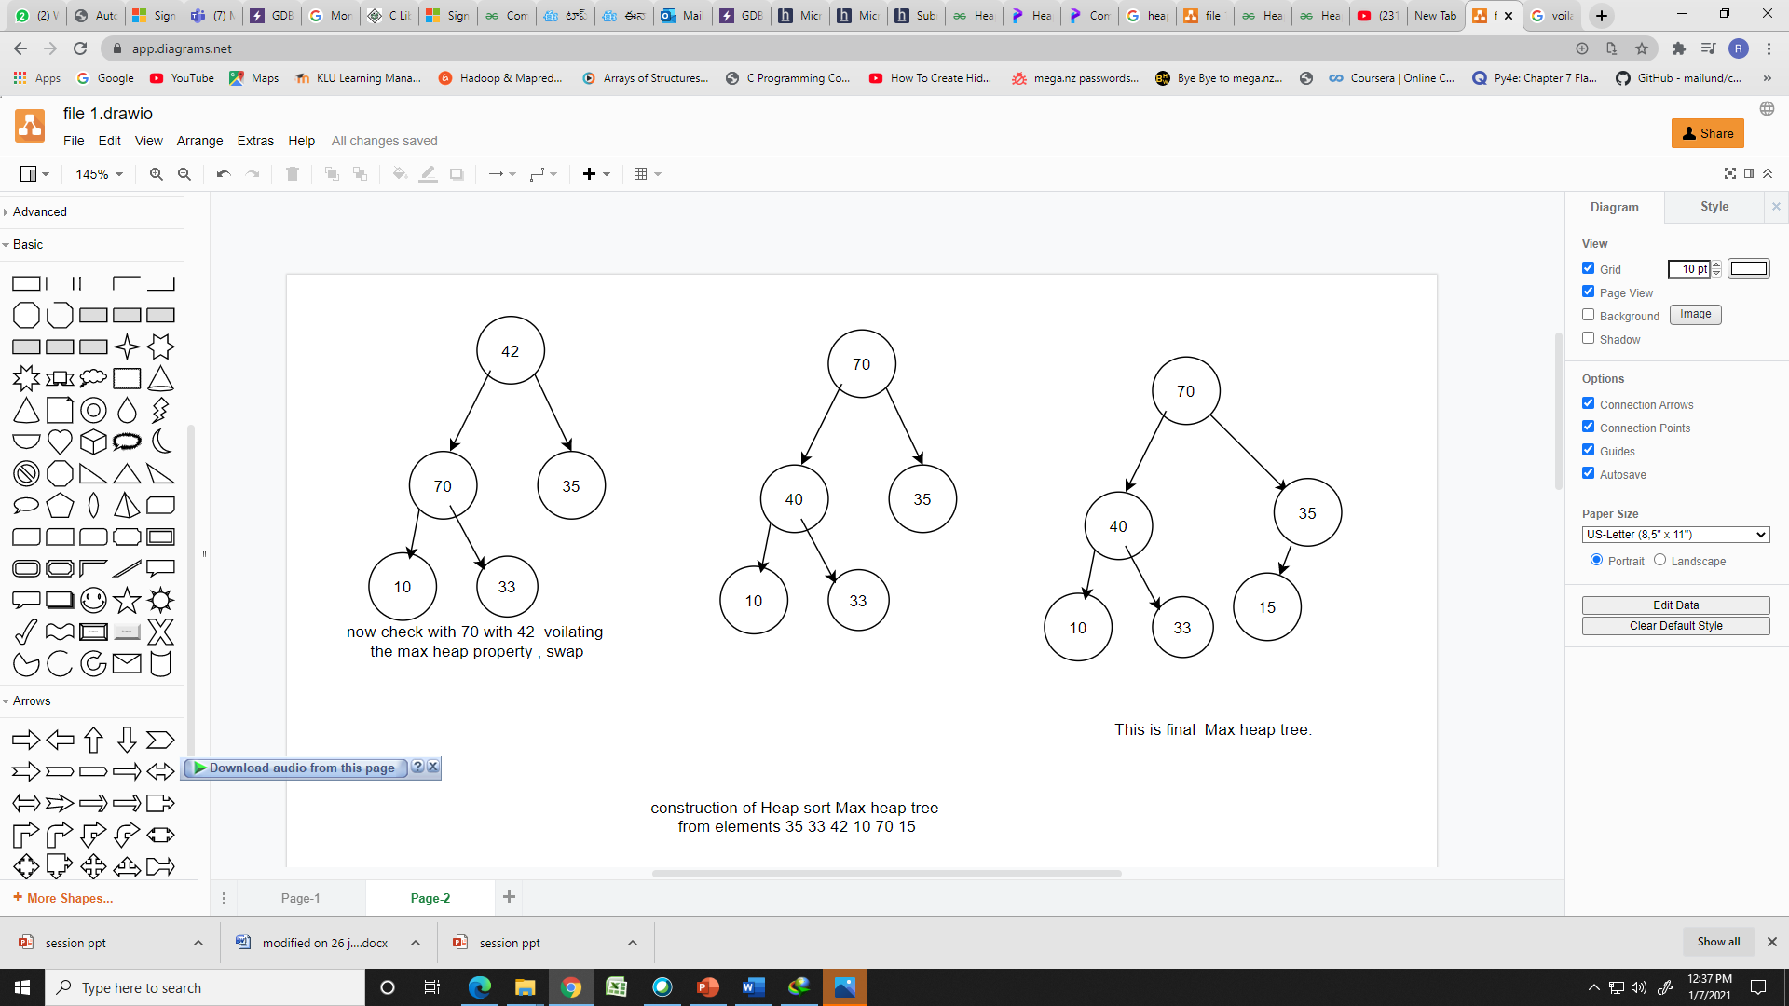
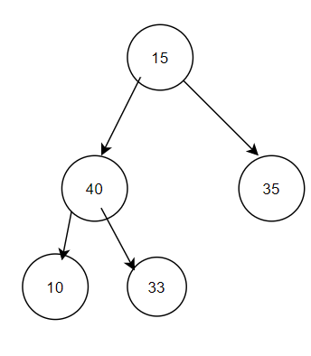
Max heap(Cont..)
We start from A, and followi
Remove the root element (70)and replace with last leaf node(15). That removing element store in Array a[]

Slide 14
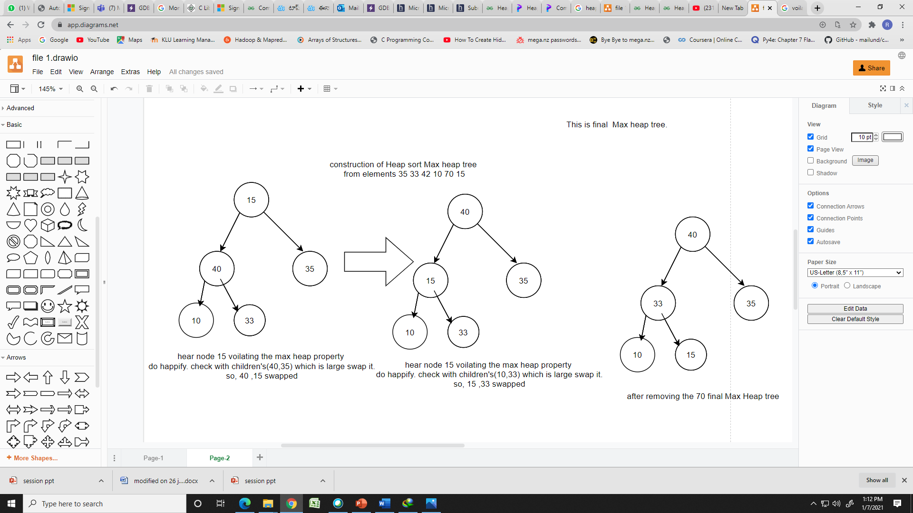
Max heap(Cont..)
A[ ]
70

Slide 15
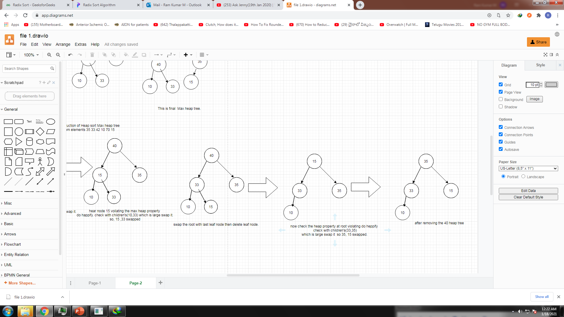
Max heap (Cont..)
A[ ]
70 | 40

Slide 16
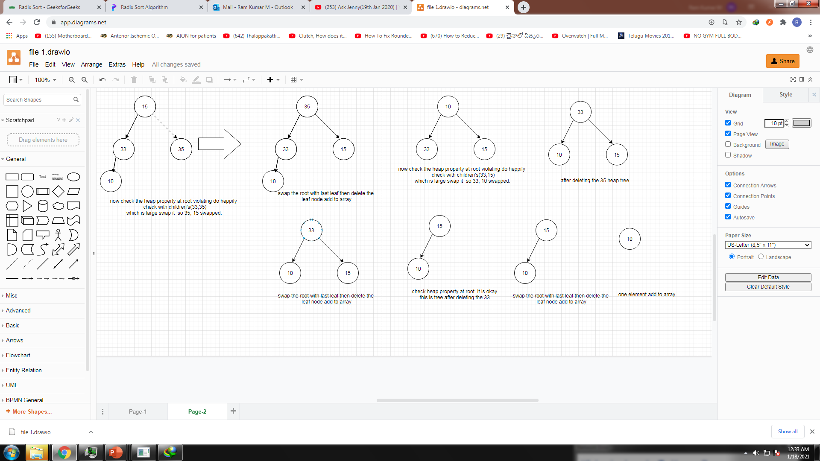
BINARY TREE (Cont..)
A[ ]
A[ ]
70 | 40 | 35 | 33 | 15 | 10
Final sorted array

Slide 17
Application of Heap Binary and Heap Sort
Heap Sort and Binary Heaps are widely used in applications such as
Priority queues,
Heap-based data structures,
Scheduling algorithms,
External sorting.
Python provides a built-in library (heapq) that implements a Min-Heap by default, and it can be adapted for a Max-Heap by negating the values.

Slide 18
SUMMARY
Key Properties of Binary Heap:
Complete Binary Tree: Every level of the tree is fully filled except possibly the last level, which is filled from left to right.
Heap Property: In a max-heap, the key of a parent node is always greater than or equal to the keys of its children; for a min-heap, the key of a parent node is always less than or equal to the keys of its children.
Heap Operations:
The main operations on a heap are:
Insert: Add an element while maintaining the heap property.
Extract (or Remove): Remove the root element (max in a max-heap, min in a min-heap) and restore the heap property.
Heapify: Rearrange the elements to maintain the heap property after an insertion or removal .
Heap Sort is an efficient, in-place sorting algorithm that can be used for both ascending and descending order sorting.

Slide 19
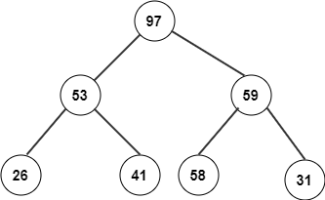
SELF-ASSESSMENT QUESTIONS
On which algorithm is heap sort based on?
Fibonacci heap
Binary tree
Priority queue
FIFO
2.Consider the following heap after build heap phase. What will be its corresponding array?
26,53,41,97,58,59,31
26,31,41,53,58,59,97
26,41,53,97,31,58,59
97,53,59,26,41,58,31

Slide 20
SELF-ASSESSMENT QUESTIONS
3. Which one of the following array elements represents a binary min heap?
12 10 8 25 14 17
8 10 12 25 14 17
25 17 14 12 10 8
14 17 25 10 12 8
4. In which heap the root node must be greatest among the keys present at all of it’s children?
min-heap
max-heap
Both A and B
None of the above

Slide 21
SELF-ASSESSMENT QUESTIONS
5. How many type of heap are there?
2
3
4
5
6. What is its wort case time complexity of Heap sort?
O(nlogn)
O(n2logn)
O(n2)
O(n3)

Slide 22
SELF-ASSESSMENT QUESTIONS
7. What is the time taken to perform a delete min operation?
O(N)
O(N log N)
O(log N)
O(N2)
8. How many arrays are required to perform deletion operation in a heap?
1
2
3
4

Slide 23
SELF-ASSESSMENT QUESTIONS
9. What is the typical running time of a heap sort algorithm?
O(N)
b) O(N log N)
c) O(log N)
d) O(N2)
10. In heap sort, after deleting the last minimum element, the array will contain elements in?
increasing sorting order
decreasing sorting order
tree inorder
tree preorder

Slide 24
TERMINAL QUESTIONS
1. Describe heap sort and heapifying with examples
2. List out the applications of heapsort
3. Analyze the time complexity of heap sort

Slide 25
REFERENCES FOR FURTHER LEARNING OF THE SESSION
Textbooks:
Mark Allen Weiss, Data Structures and Algorithm Analysis in C, 2010, Second Edition, Pearson Education.
Allen B. Downey, ”Think Python: How to Think Like a Computer Scientist’’, 2nd edition, Updated for Python 3, Shroff/O’Reilly Publishers, 2016 (http://greenteapress.com/wp/thinkpython/)
Data Structures and algorithms using python, 2011,Rance D, Necaise, himilton printing
ReferenceBooks:
Data Structures and Algorithm Analysis in PYTHON, 2010, Mark Allen Weiss, Second Edition, Pearson Education.
Data Structures and Algorithms, A.V.Aho, J.E.Hopcroft, and J.D.Ullman, Pearson Education, First Edition Reprint2003.
Advanced Guide to Python 3 Programming, John Hunt, 4th Edition, Springer Nature Switzerland AG 2019.
Python Basics: A Practice Introduction to Python 3, David Amos, Dan Bader, Joanna Jablonski, Fletcher Heisler, 4th edition, Real Python.
WebLinks:
https://docs.python.org/3/tutorial/datastructures.html
https://www.w3schools.com/dsa/dsa_intro.php
https://www.geeksforgeeks.org/python-data-structures/

Slide 26
THANK YOU
Team – Course Name

